Slide 1

Introduction to Modern App Development
Rockford Lhotka
CTO
Level: Intermediate

Slide 2
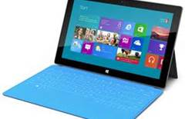

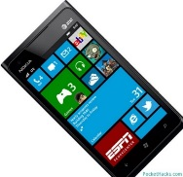
About Modern Apps Live!
Unique conference format
One “track” cutting across “tracks”
How to build modern apps end-to-end
ALM
Architecture
Design
Development
Testing
Leveraging your data

Slide 3
Primary Change Drivers
Touch and tablets
Personal integration
End of Moore’s Law (???)
Parallelization
Cloud data/processing
Social integration
Mobile devices

Slide 4
Assumed Constants
Consumers drive expectations
Enterprises move slowly
Natural monopoly effect
Enterprises need predictability

Slide 5
Impact
Client
Server (cloud)

Slide 6

iPad
Most popular tablet (US)
Cause of BYOD
Dev platform
Native Objective C
HTML 5/JavaScript
.NET - Xaramin

Slide 7

Android
Most popular phone/tablet (global)
Cause of BYOD
Dev platform
Java
HTML 5/JavaScript
.NET - Xamarin

Slide 8
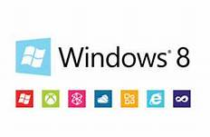
Windows 8.1
Latest Microsoft OS
Run existing apps + mobile
Dev platform
WinRT
HTML 5/JavaScript
.NET – Desktop or WinRT

Slide 9
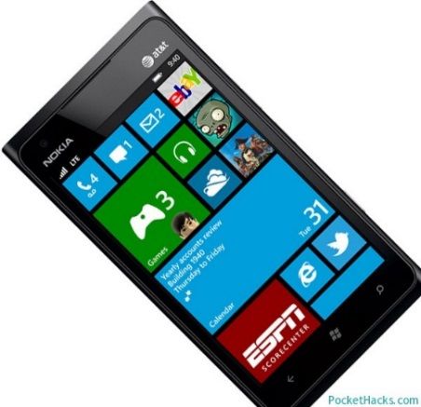
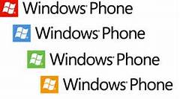
Windows Phone
Windows Phone 8
Windows 8 kernel
Dev platform
WinRT or Silverlight
HTML 5/JavaScript
.NET - WinRT

Slide 10
Potential Server Futures
Cloud
Public
Private
Data centers
Fading away

Slide 11
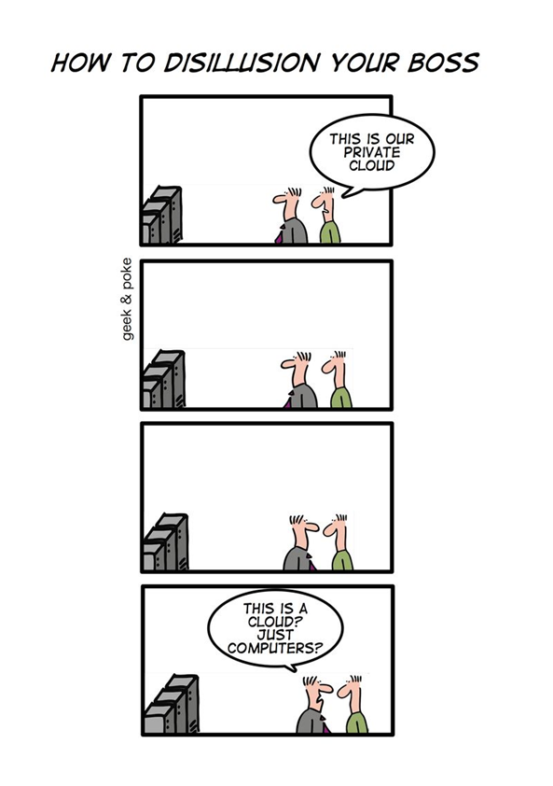

Slide 12



Cloud Computing Models
SOFTWARE
as a SERVICE
PLATFORM
as a SERVICE
INFRASTRUCTURE
as a SERVICE

Slide 13




MyVote App Architecture
HTML 5 UI
iOS UI
WinPhone UI
WinRT UI
Android UI
JavaScript BL
BL
BL
BL
BL
Service Proxy
Data Portal
Data Portal
Data Portal
Data Portal
Reports
SQL Reporting
REST API
Data Portal
ASP.NET WA
BL
Excel
DAL
PowerPivot
SQL Database
Blobs

Slide 14
MyVote Team
Rocky Lhotka
Architect/PM
Jason Bock
Business dev
Brent Edwards
XAML UI dev
Brian Randell
TFS/ALM lead
Joshua Janssen
QA/Test
Steve Hughes
Data/BI
Kasey Schindler
iPad dev
Anthony Handley
Design lead
Billy Hollis
Design oversight
Aaron Notestad
XAML dev
Andy Tinkham
QA lead
Nick Landry
iPad advisor

Slide 15
Tools and Technologies
Visual Studio Online with git
visualstudio.com
Visual Studio 2013
Azure SDK
Azure Mobile SDK
Windows Phone 8 SDK
SQL Server Data Tools
Web tools (Web API)
Xamarin for Android and iOS
Azure
Cloud services
SQL
Blob storage
Mobile services

Slide 16
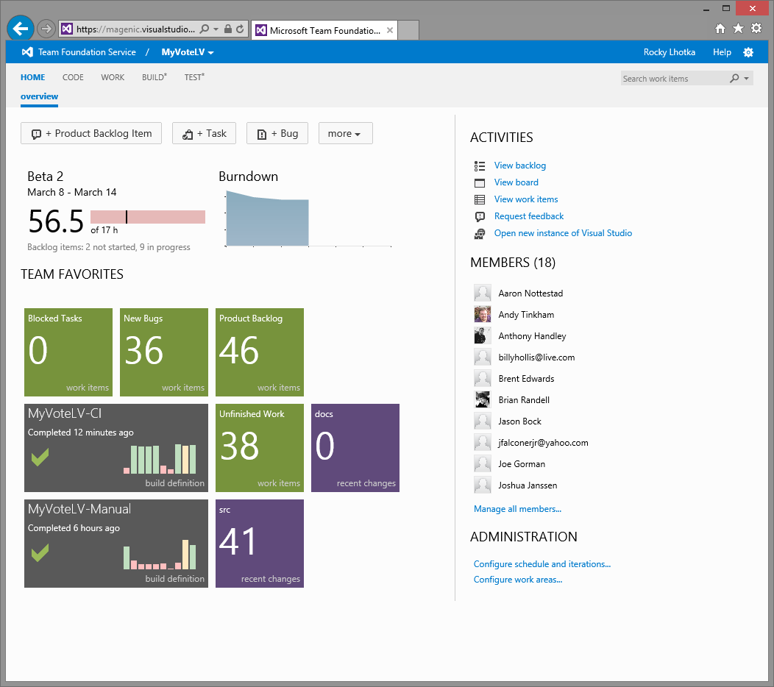
Project/Team Management

Slide 17
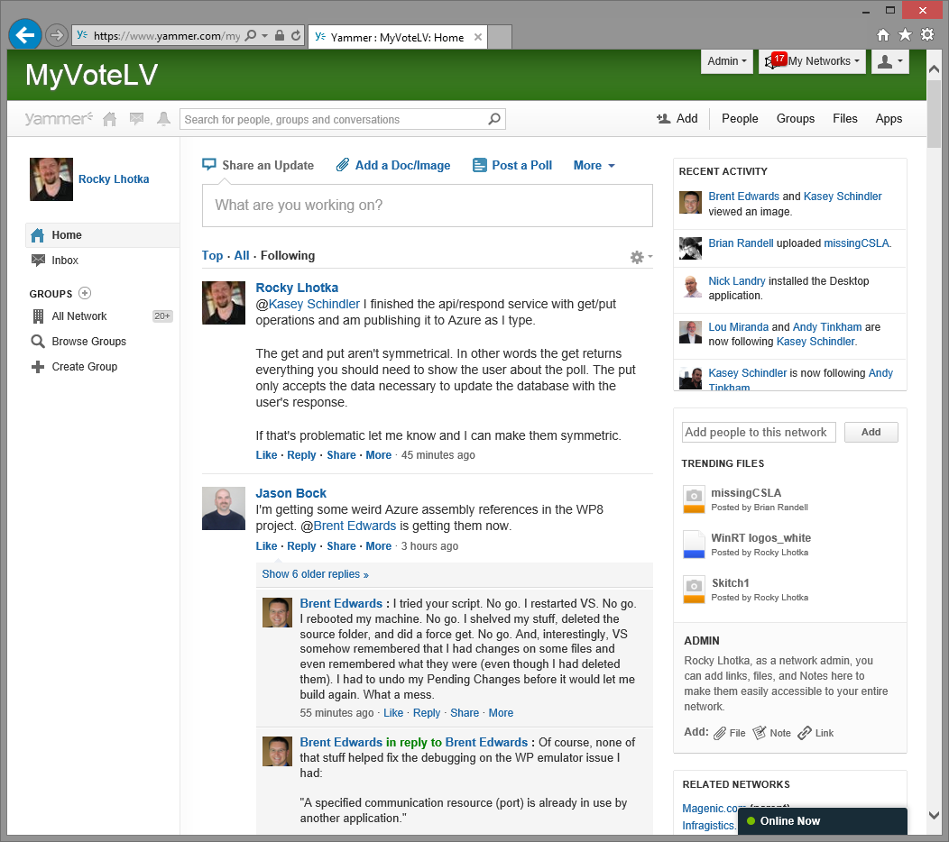
Distributed Communication

Slide 18
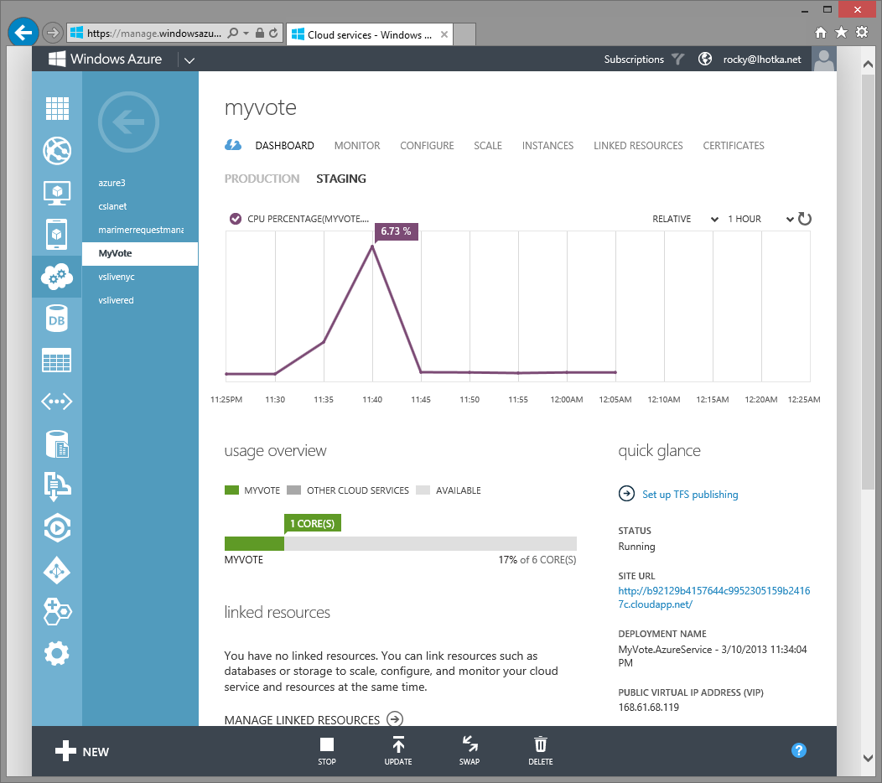
App Server

Slide 19
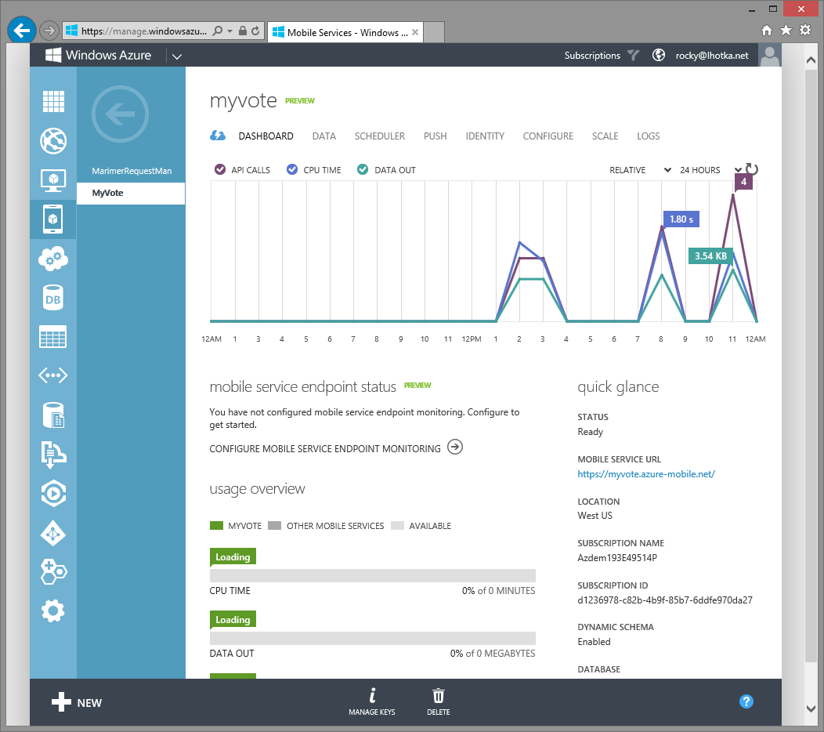
Mobile Services

Slide 20
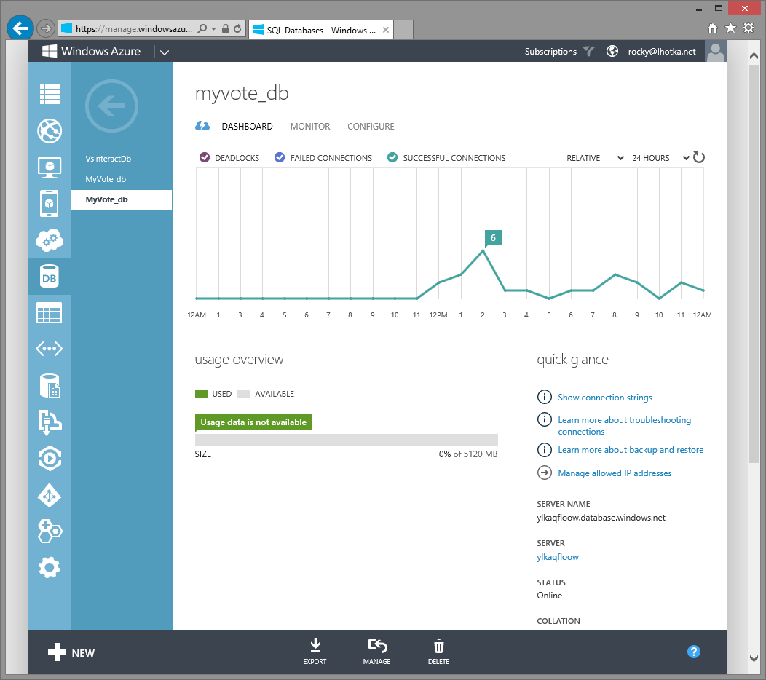
SQL Database

Slide 21
Modern App Walkthrough

Slide 22
Going Forward
TFS/ALM
Modern App Architecture
Modern App Design
Developer Testing
Data Access and SQL Server
Application Server and Azure
User Experience Nuts and Bolts
Xamarin Overview (Android, iOS)
Xamarin.Forms (Android, iOS)
Windows and Windows Phone Universal App
Business Intelligence
ALM, TFS, and git
HTML 5/JavaScript Client

Slide 23
Modern Apps: Mobile, Cross-Device & Cloud Development

Slide 24

Thank you!
Rockford Lhotka
rockyl@magenic.com

